Slide 1
Update for datasets analysis
Team Dragonflies
Jing Wang, Yuan Li

Slide 2
Table of content
Dataset analysis for Airbnb
Overview
Pros and cons
Trend
Next steps
Dataset analysis for Expedia
Overview of dataset
Data processing
Data modeling
Important features
Residual plot for prediction

Slide 3
Airbnb dataset overview
Available data for multiple cities
Dataset for US is 9.6MB
96 features
1960 unique users
Date & price and room & price are in different datasets

Slide 4
Pros and cons
Pros:
84 datasets for different geography including major cities in US, Europe and China
96 different features for every user_id including numbers and text
Price for the different dates are provided
Cons:
Date & price and room & price are in different dataset, need more effort to consolidate them
For different room, price are in different date, hard to compare them
No location strength information provided, for example, the distant to downtown
Most information are in text, need to do text mining for deep investigation

Slide 5
Trend and next steps
Trend discovered so far:
For the same room, price is constant within a month
For large room with more beds, get the higher price for the similar address
Next steps:
Work on text mining to analyze the connection between facilities and price
Check if review comments impact the price
Investigate the big events’ impact on the price (need to find out the data)

Slide 6
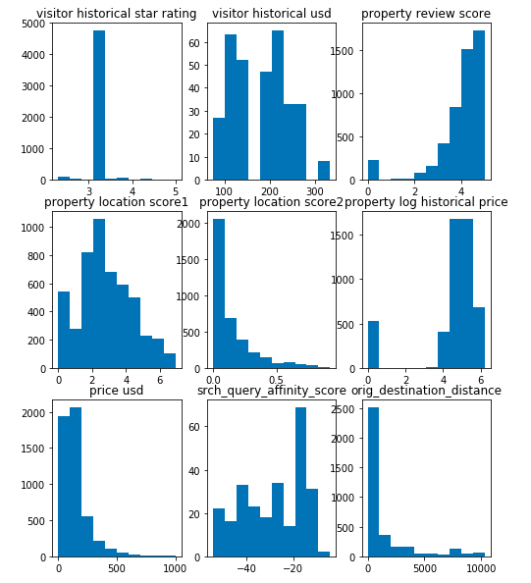
Expedia Dataset overview
The histogram plots of several continuous features in Expedia dataset help us to have better understanding of what the dataset looks like.
We can tell that our target -- “price_usd” is highly skewed. So in order to have better performance of the prediction, it may be better to log-transform “price_usd”.

Slide 7
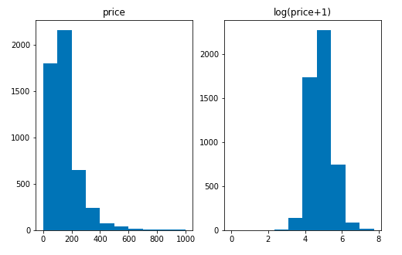
Expedia Data Processing
To process the data, we log-transformed the skewed numeric features that show a skewed score of over 0.75. Then we filled NA values with the mean of the column.

Slide 8
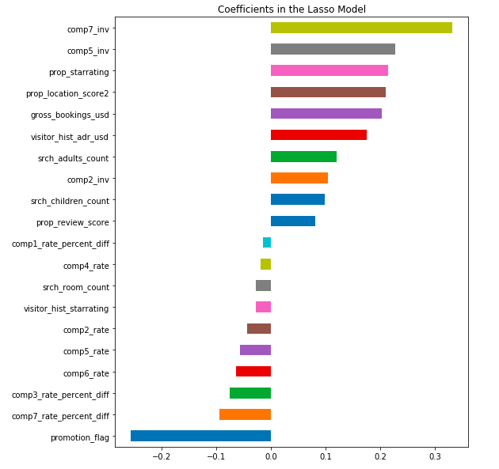
Expedia Data modeling
We want to see if there are indicative features that would impact hotel prices listed.
So we built a regularized regression model using Lasso, and get the feature importance that would give us a better sense of which features worth more investigation.
the most important features are comp7_inv, comp5_inv, prop_starrating, prop_location_score2, gross_bookings_usd, visitor_hist_adr_usd

Slide 9
Summary of Important Features
Competitor 7 and 5's availability (comp7_inv, comp5_inv) have the most impact on Expedia's list prices, followed by the star rating of the hotel (prop_starrating).
Other factors that seem to have much influence on listed hotel price on Expedia is the location of the hotel (prop_location_score2).
Total value of transaction, which is different from price_usd due to taxes,fees, conventions and multiple day bookings, etc., also has effect on listed price.
Moreover, Visitors' historical purchase amount -- the mean price per night (in USD) of the hotels the customer has previously purchased (visitor_hist_adr_usd) would also influence the listed price of a hotel.

Slide 10
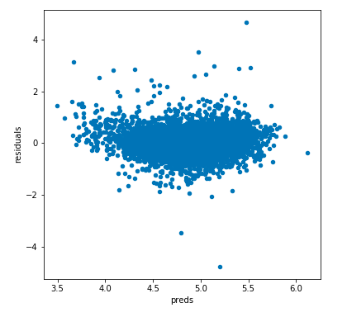
Residual Plot
The residual plot looks pretty good, which indicates that we can use regression method to predict on the test set.

Slide 11
Questions & Next step
Expedia dataset:
Modeling flowing data needs to take a different approach and can be more complicated, e.g., predicting hotel prices within a specific time range. However, so far we have not yet included the "date_time" feature to our model to predict hotel price.
Since the dataset is quite sparse, we are not sure whether it make sense or not to replace NA values with mean value of a specific column. For example, some columns only have about 300 non-NA values, yet compared to the data size (more than 10,000 records), this is pretty small.

